Slide 1
Ayudantía #1
Lógica Digital
Ayudantes:
Tomás Contreras
Susana Figueroa
Andrés González
Rodrigo Alonso
Laurence Golborne

Slide 2
Convierte de base decimal a base 2
(10)₁₀
(457)₁₀
(2)₁₀

Slide 3
(10)₁₀

Slide 4
(10)₁₀
Resto
10 : 2 = 5
0

Slide 5
(10)₁₀
Resto
10 : 2 = 5
0
5 : 2 = 2
10

Slide 6
(10)₁₀
Resto
10 : 2 = 5
0
5 : 2 = 2
10
2 : 2 = 1
010

Slide 7
(10)₁₀
Resto
10 : 2 = 5
0
5 : 2 = 2
10
2 : 2 = 1
010
1 : 2 = 0
1010

Slide 8
(10)₁₀
Resto
10 : 2 = 5
0
5 : 2 = 2
10
2 : 2 = 1
010
1 : 2 = 0
1010
R: (1010)₂

Slide 9
(10)₁₀
En 8 bits?

Slide 10
(10)₁₀
En 8 bits?
R: (00001010)₂

Slide 11
2) (457)₁₀

Slide 12
2) (457)₁₀
Resto
457 : 2 = 228
1

Slide 13
2) (457)₁₀
Resto
457 : 2 = 228
1
228 : 2 = 114
01

Slide 14
2) (457)₁₀
Resto
457 : 2 = 228
1
228 : 2 = 114
01
114 : 2 = 57
001

Slide 15
2) (457)₁₀
Resto
457 : 2 = 228
1
228 : 2 = 114
01
114 : 2 = 57
001
57 : 2 = 28
1001

Slide 16
2) (457)₁₀
Resto
457 : 2 = 228
1
228 : 2 = 114
01
114 : 2 = 57
001
57 : 2 = 28
1001
28 : 2 = 14
01001

Slide 17
2) (457)₁₀
Resto
457 : 2 = 228
1
228 : 2 = 114
01
114 : 2 = 57
001
57 : 2 = 28
1001
28 : 2 = 14
01001
...
...
1 : 2 = 0
R: (111001001)₂

Slide 18


2) 457₁₀
Tiene más de 8 bits???

Slide 19
2) (457)₁₀
Tiene más de 8 bits???
Desde el 256 ya supera los 8 bits

Slide 20
3) (2)₁₀

Slide 21
3) (2)₁₀
Resto
2 : 2 = 1
0

Slide 22
3) (2)₁₀
Resto
2 : 2 = 1
0
1 : 2 = 0
10

Slide 23
3) (2)₁₀
Resto
2 : 2 = 1
0
1 : 2 = 0
10
R: (10)₂

Slide 24
3) (2)₁₀
En 8 bits?

Slide 25
3) (2)₁₀
En 8 bits?
R: (00000010)₂

Slide 26

Convierte de base 2 a base 16
(1000)₂
(00101001)₂
(0101100)₂

Slide 27
(1000)₂

Slide 28
(1000)₂
en base 10!
1 0 0 0
x2³ x2² x2¹ x2⁰

Slide 29
(1000)₂
en base 16!
1 0 0 0
x2³ x2² x2¹ x2⁰

Slide 30
(1000)₂
en base 16!
1 0 0 0
x2³ x2² x2¹ x2⁰
R: (8)₁₆

Slide 31
2) (00101001)₂

Slide 32
2) (00101001)₂
en base 10!
0 0 1 0 1 0 0 1
x2⁷ x2⁶ x2⁵ x2⁴ x2³ x2² x2¹ x2⁰

Slide 33
2) (00101001)₂
0 0 1 0 1 0 0 1
x2⁷ x2⁶ x2⁵ x2⁴ x2³ x2² x2¹ x2⁰

Slide 34
2) (00101001)₂
en base 16!
0 0 1 0 1 0 0 1
x2³ x2² x2¹ x2⁰ x2³ x2² x2¹ x2⁰

Slide 35
2) (00101001)₂
0 0 1 0 1 0 0 1
x2³ x2² x2¹ x2⁰ x2³ x2² x2¹ x2⁰
R1: 2
R2: 9

Slide 36
2) (00101001)₂
0 0 1 0 1 0 0 1
x2³ x2² x2¹ x2⁰ x2³ x2² x2¹ x2⁰
R1: 2
R2: 9
R: (29)₁₆

Slide 37
3) (0101100)₂

Slide 38

3) (0101100)₂
!!!?!?Solo tengo 7 bits???

Slide 39
3) (0101100)₂
0 0 1 0 1 1 0 0
x2⁷ x2⁶ x2⁵ x2⁴ x2³ x2² x2¹ x2⁰

Slide 40
3) (0101100)₂
0 0 1 0 1 1 0 0
x2⁷ x2⁶ x2⁵ x2⁴ x2³ x2² x2¹ x2⁰

Slide 41
3) (0101100)₂
0 0 1 0 1 1 0 0
x2³ x2² x2¹ x2⁰ x2³ x2² x2¹ x2⁰

Slide 42
3) (0101100)₂
0 0 1 0 1 1 0 0
x2³ x2² x2¹ x2⁰ x2³ x2² x2¹ x2⁰
R1: 2
R2: 12 = C

Slide 43
3) (0101100)₂
0 0 1 0 1 1 0 0
x2³ x2² x2¹ x2⁰ x2³ x2² x2¹ x2⁰
R1: 2
R2: 12 = C
R: (2C)₁₆

Slide 44
Cómo convertir de hexadecimal a binario?

Slide 45
Cómo convertir de hexadecimal a binario?
proceso inverso

Slide 46
Convierte de base 16 a base 2
(8)₁₆
(2C)₁₆
(98BA)₁₆

Slide 47
(8)₁₆

Slide 48
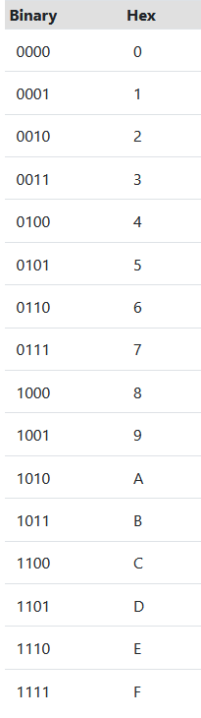
Binary Hex
(8)₁₆

Slide 49
Binary Hex
(8)₁₆

Slide 50
Binary Hex
(8)₁₆
R: (1000)₂

Slide 51
2) (2C)₁₆

Slide 52
Binary Hex
2) (2C)₁₆

Slide 53
Binary Hex
2) (2C)₁₆

Slide 54
Binary Hex
2) (2C)₁₆
R: (0010 1100)₂

Slide 55
3) (98BA)₁₆

Slide 56
Binary Hex
3) (98BA)₁₆

Slide 57
Binary Hex
3) (98BA)₁₆
segundo
primero
cuarto
tercero

Slide 58
Binary Hex
3) (98BA)₁₆
segundo
primero
cuarto
tercero
R: (1001 1000 1011 1010)₂

Slide 59
Algebra Booleana

Slide 60
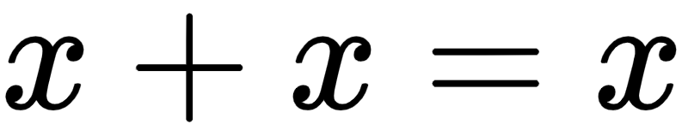
Demostrar la propiedad de Idempotencia 1:

Slide 62
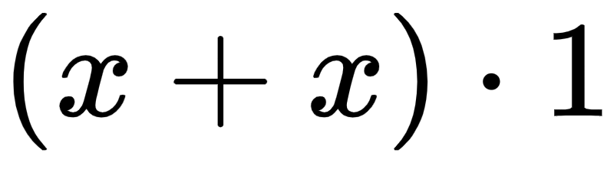

Slide 63
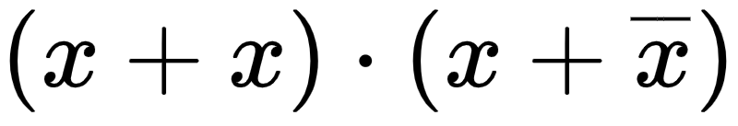

Slide 64
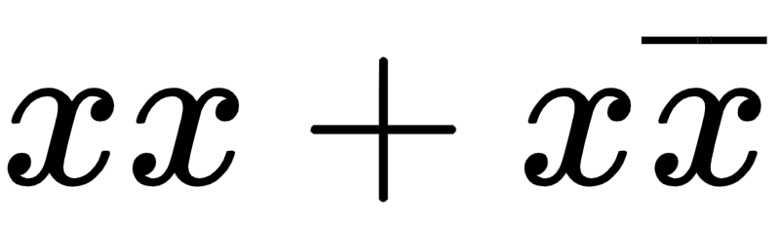

Slide 65
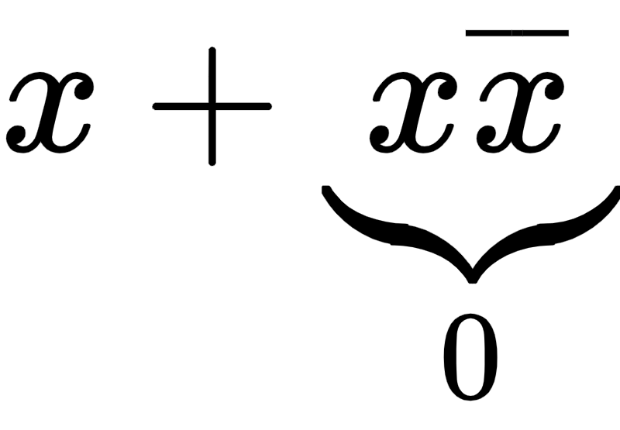

Slide 66


Slide 67
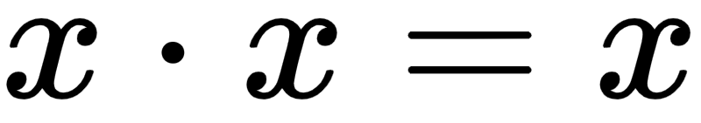
Demostrar la propiedad de Idempotencia 2:

Slide 69
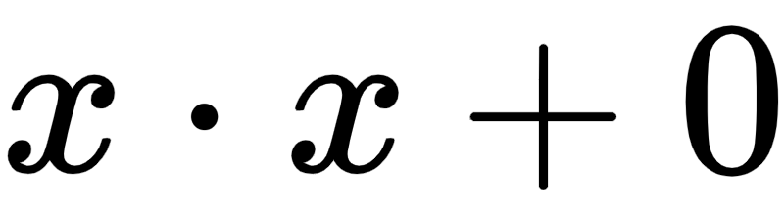

Slide 70
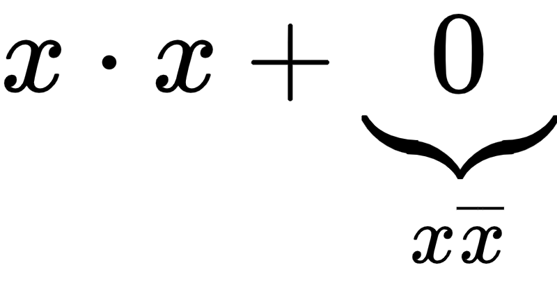

Slide 72
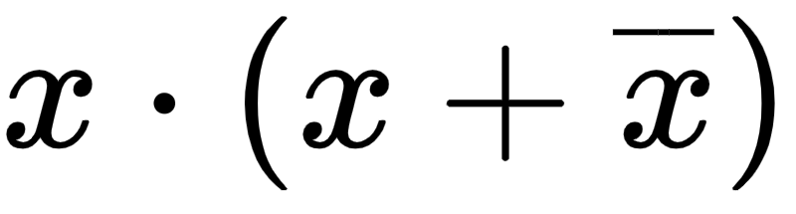

Slide 73
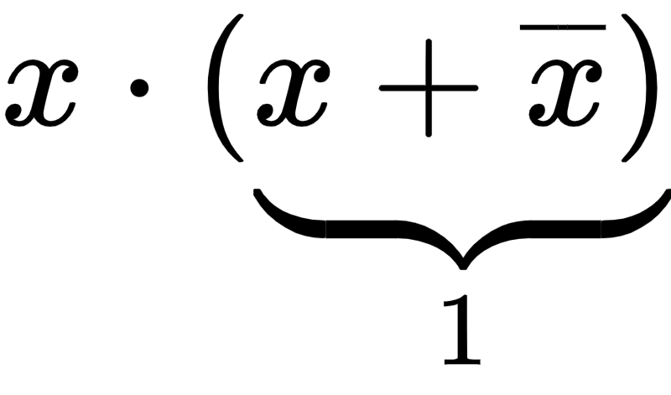

Slide 74
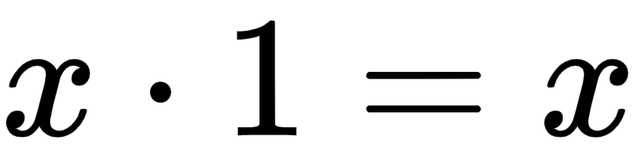

Slide 75
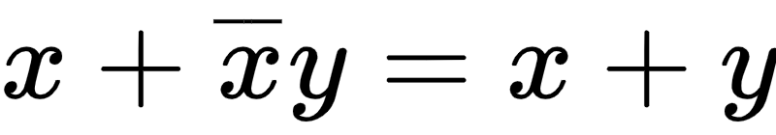
Demostrar la propiedad de Ley del consenso:

Slide 77

Por propiedad distributiva

Slide 78

Por propiedad distributiva

Slide 79
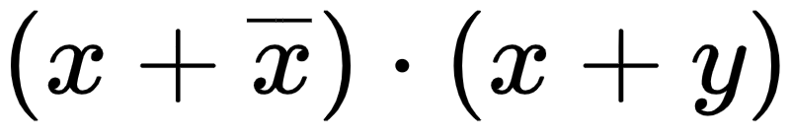

Slide 80
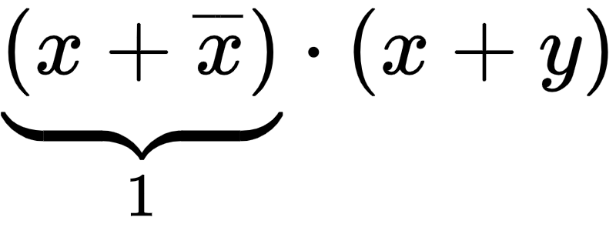

Slide 81
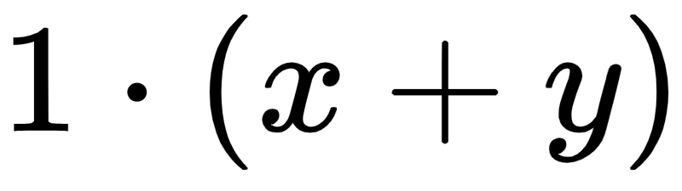

Slide 82
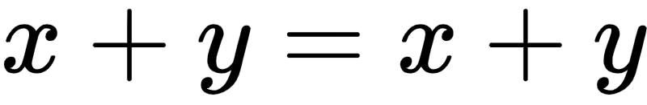

Slide 83
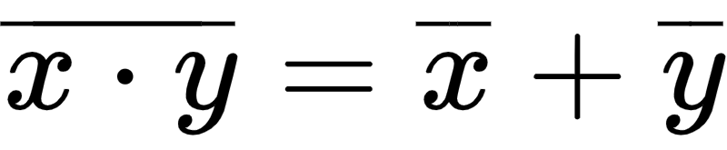
Demostrar la propiedad de Ley De-Morgan:

Slide 85
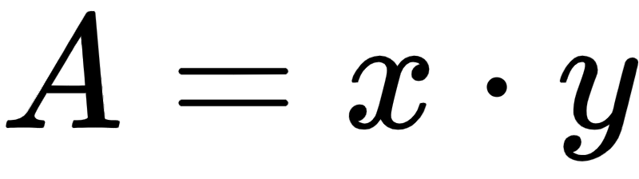
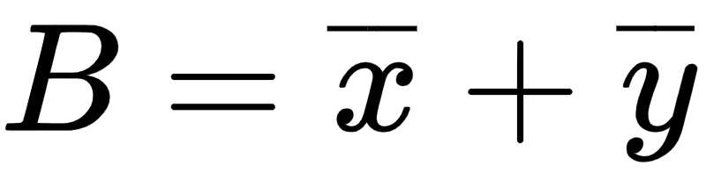

Slide 87
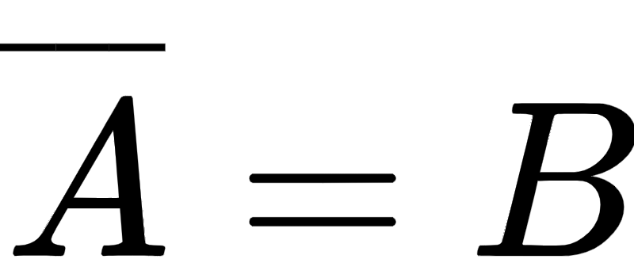

Slide 88
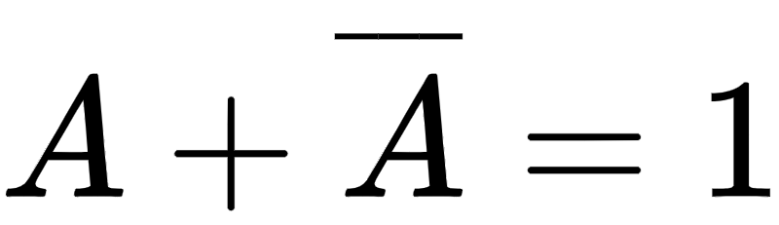
Se debe cumplir que:

Slide 89
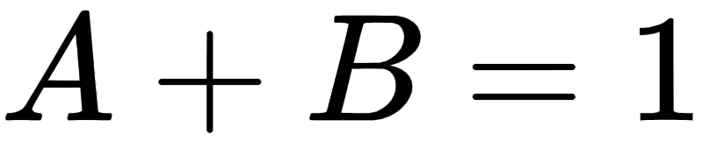
Se debe cumplir que:

Slide 90
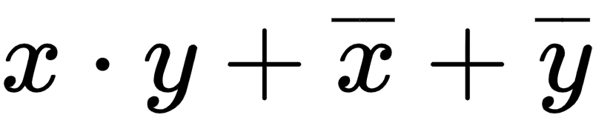
Se debe cumplir que:

Slide 91
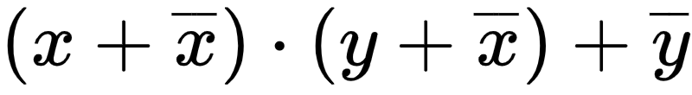
Se debe cumplir que:

Slide 92
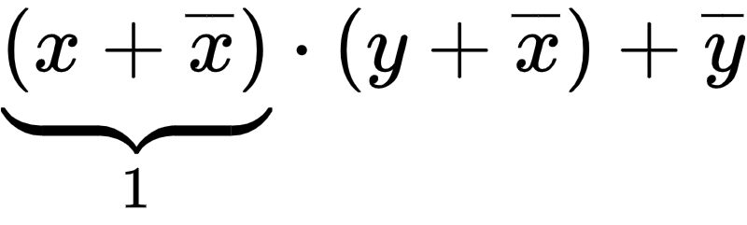
Se debe cumplir que:

Slide 93
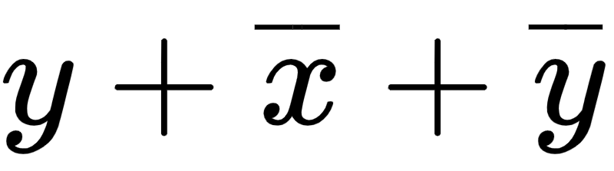
Se debe cumplir que:

Slide 94
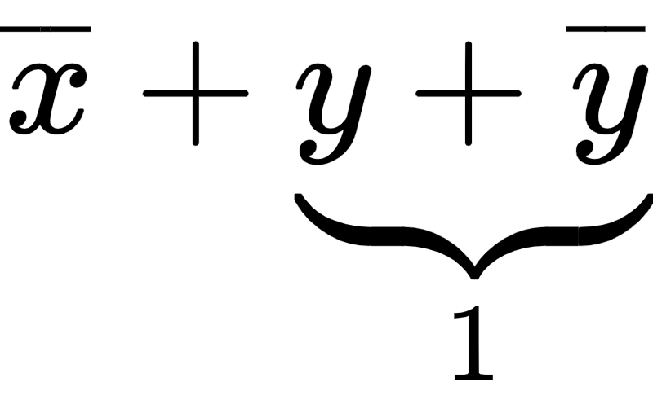
Se debe cumplir que:

Slide 95
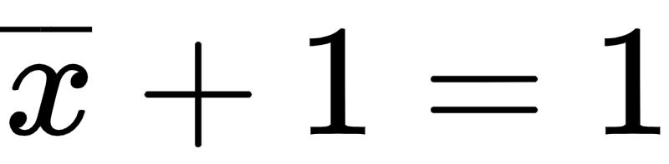
Se debe cumplir que:

Slide 96
Se debe cumplir que:

Slide 97
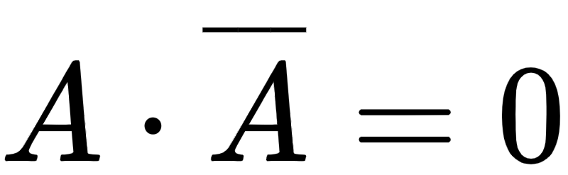
Simultáneamente se debe cumplir que:

Slide 98
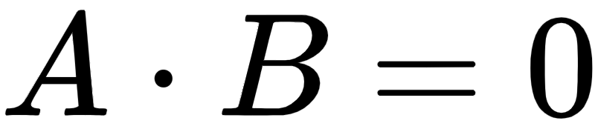
Simultáneamente se debe cumplir que:

Slide 99
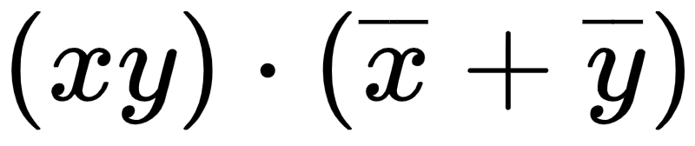
Simultáneamente se debe cumplir que:

Slide 100
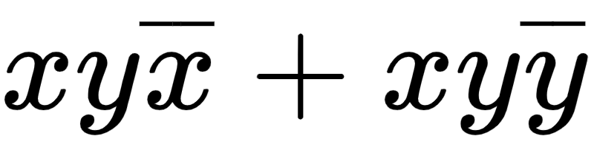
Simultáneamente se debe cumplir que:

Slide 101
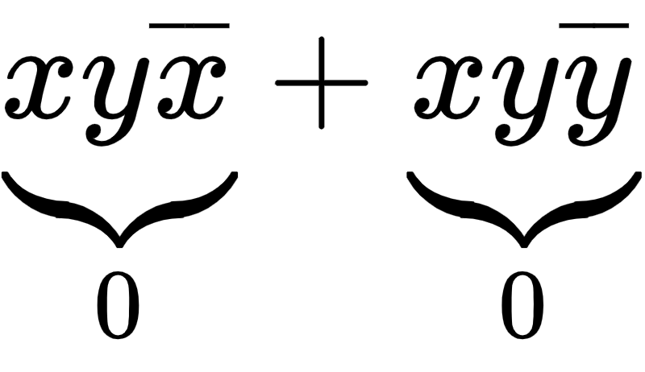
Simultáneamente se debe cumplir que:

Slide 102
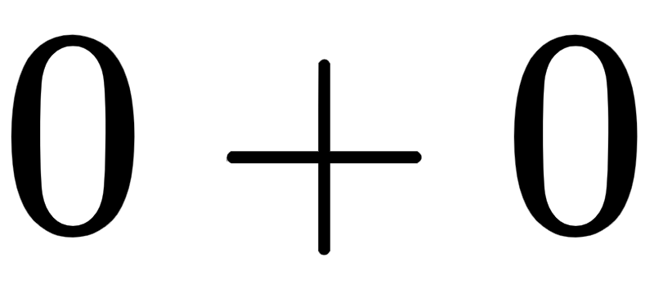
Simultáneamente se debe cumplir que:

Slide 103
Simultáneamente se debe cumplir que:

Slide 104
(1)
(2)
Como (1) y (2) se cumplen, se comprueba la igualdad.

Slide 105
Repaso de las compuertas lógicas básicas

Slide 106
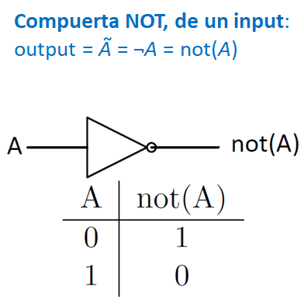

Slide 107
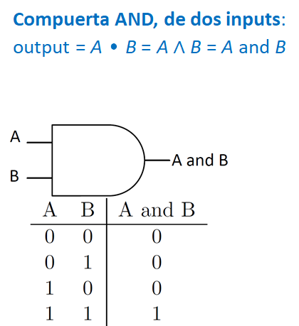

Slide 108
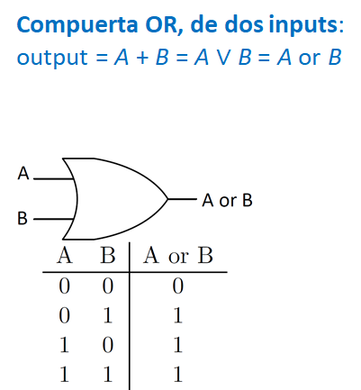

Slide 109
Construir la tabla de verdad de la siguiente expresión:

Slide 110
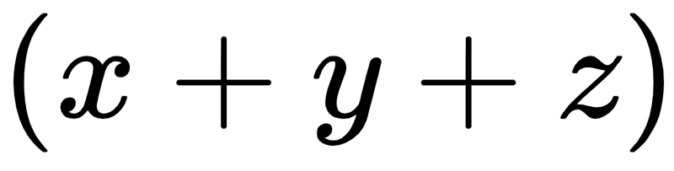
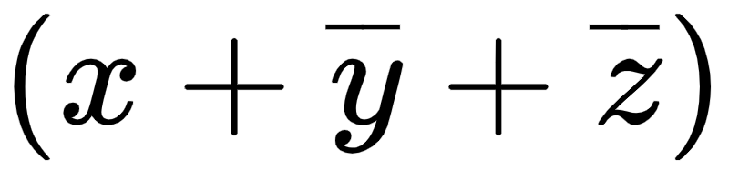
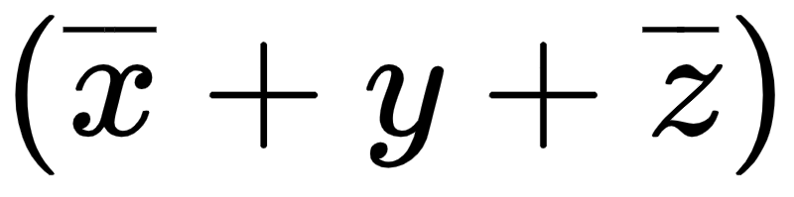
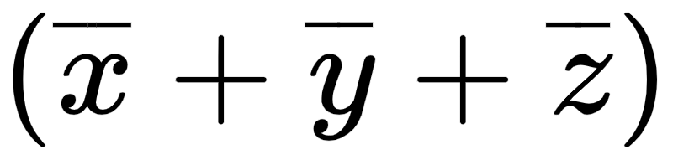
x | y | z | f (x, y, z)
0 | 0 | 0
0 | 0 | 1
0 | 1 | 0
0 | 1 | 1
1 | 0 | 0
1 | 0 | 1
1 | 1 | 0
1 | 1 | 1

Slide 111
x | y | z | f (x, y, z)
0 | 0 | 0
0 | 0 | 1
0 | 1 | 0
0 | 1 | 1
1 | 0 | 0
1 | 0 | 1
1 | 1 | 0
1 | 1 | 1
0

Slide 112
x | y | z | f (x, y, z)
0 | 0 | 0
0 | 0 | 1
0 | 1 | 0
0 | 1 | 1
1 | 0 | 0
1 | 0 | 1
1 | 1 | 0
1 | 1 | 1
0
1

Slide 113
x | y | z | f (x, y, z)
0 | 0 | 0
0 | 0 | 1
0 | 1 | 0
0 | 1 | 1
1 | 0 | 0
1 | 0 | 1
1 | 1 | 0
1 | 1 | 1
0
1
1

Slide 114
x | y | z | f (x, y, z)
0 | 0 | 0
0 | 0 | 1
0 | 1 | 0
0 | 1 | 1
1 | 0 | 0
1 | 0 | 1
1 | 1 | 0
1 | 1 | 1
0
1
1
1

Slide 115
x | y | z | f (x, y, z)
0 | 0 | 0 | 0
0 | 0 | 1
0 | 1 | 0
0 | 1 | 1
1 | 0 | 0
1 | 0 | 1
1 | 1 | 0
1 | 1 | 1

Slide 116
x | y | z | f (x, y, z)
0 | 0 | 0 | 0
0 | 0 | 1
0 | 1 | 0
0 | 1 | 1
1 | 0 | 0
1 | 0 | 1
1 | 1 | 0
1 | 1 | 1

Slide 117
x | y | z | f (x, y, z)
0 | 0 | 0 | 0
0 | 0 | 1
0 | 1 | 0
0 | 1 | 1
1 | 0 | 0
1 | 0 | 1
1 | 1 | 0
1 | 1 | 1
1

Slide 118
x | y | z | f (x, y, z)
0 | 0 | 0 | 0
0 | 0 | 1
0 | 1 | 0
0 | 1 | 1
1 | 0 | 0
1 | 0 | 1
1 | 1 | 0
1 | 1 | 1
1
1

Slide 119
x | y | z | f (x, y, z)
0 | 0 | 0 | 0
0 | 0 | 1
0 | 1 | 0
0 | 1 | 1
1 | 0 | 0
1 | 0 | 1
1 | 1 | 0
1 | 1 | 1
1
1
1

Slide 120
x | y | z | f (x, y, z)
0 | 0 | 0 | 0
0 | 0 | 1
0 | 1 | 0
0 | 1 | 1
1 | 0 | 0
1 | 0 | 1
1 | 1 | 0
1 | 1 | 1
1
1
1
1

Slide 121
x | y | z | f (x, y, z)
0 | 0 | 0 | 0
0 | 0 | 1 | 1
0 | 1 | 0
0 | 1 | 1
1 | 0 | 0
1 | 0 | 1
1 | 1 | 0
1 | 1 | 1

Slide 122
x | y | z | f (x, y, z)
0 | 0 | 0 | 0
0 | 0 | 1 | 1
0 | 1 | 0
0 | 1 | 1
1 | 0 | 0
1 | 0 | 1
1 | 1 | 0
1 | 1 | 1

Slide 123
x | y | z | f (x, y, z)
0 | 0 | 0 | 0
0 | 0 | 1 | 1
0 | 1 | 0
0 | 1 | 1
1 | 0 | 0
1 | 0 | 1
1 | 1 | 0
1 | 1 | 1
1

Slide 124
x | y | z | f (x, y, z)
0 | 0 | 0 | 0
0 | 0 | 1 | 1
0 | 1 | 0
0 | 1 | 1
1 | 0 | 0
1 | 0 | 1
1 | 1 | 0
1 | 1 | 1
1
1

Slide 125
x | y | z | f (x, y, z)
0 | 0 | 0 | 0
0 | 0 | 1 | 1
0 | 1 | 0
0 | 1 | 1
1 | 0 | 0
1 | 0 | 1
1 | 1 | 0
1 | 1 | 1
1
1
1

Slide 126
x | y | z | f (x, y, z)
0 | 0 | 0 | 0
0 | 0 | 1 | 1
0 | 1 | 0
0 | 1 | 1
1 | 0 | 0
1 | 0 | 1
1 | 1 | 0
1 | 1 | 1
1
1
1
1

Slide 127
x | y | z | f (x, y, z)
0 | 0 | 0 | 0
0 | 0 | 1 | 1
0 | 1 | 0 | 1
0 | 1 | 1
1 | 0 | 0
1 | 0 | 1
1 | 1 | 0
1 | 1 | 1

Slide 128
x | y | z | f (x, y, z)
0 | 0 | 0 | 0
0 | 0 | 1 | 1
0 | 1 | 0 | 1
0 | 1 | 1
1 | 0 | 0
1 | 0 | 1
1 | 1 | 0
1 | 1 | 1

Slide 129
x | y | z | f (x, y, z)
0 | 0 | 0 | 0
0 | 0 | 1 | 1
0 | 1 | 0 | 1
0 | 1 | 1
1 | 0 | 0
1 | 0 | 1
1 | 1 | 0
1 | 1 | 1
1

Slide 130
x | y | z | f (x, y, z)
0 | 0 | 0 | 0
0 | 0 | 1 | 1
0 | 1 | 0 | 1
0 | 1 | 1
1 | 0 | 0
1 | 0 | 1
1 | 1 | 0
1 | 1 | 1
1
0

Slide 131
x | y | z | f (x, y, z)
0 | 0 | 0 | 0
0 | 0 | 1 | 1
0 | 1 | 0 | 1
0 | 1 | 1
1 | 0 | 0
1 | 0 | 1
1 | 1 | 0
1 | 1 | 1
1
0
1

Slide 132
x | y | z | f (x, y, z)
0 | 0 | 0 | 0
0 | 0 | 1 | 1
0 | 1 | 0 | 1
0 | 1 | 1
1 | 0 | 0
1 | 0 | 1
1 | 1 | 0
1 | 1 | 1
1
0
1
1

Slide 133
x | y | z | f (x, y, z)
0 | 0 | 0 | 0
0 | 0 | 1 | 1
0 | 1 | 0 | 1
0 | 1 | 1 | 0
1 | 0 | 0
1 | 0 | 1
1 | 1 | 0
1 | 1 | 1

Slide 134
x | y | z | f (x, y, z)
0 | 0 | 0 | 0
0 | 0 | 1 | 1
0 | 1 | 0 | 1
0 | 1 | 1 | 0
1 | 0 | 0
1 | 0 | 1
1 | 1 | 0
1 | 1 | 1

Slide 135
x | y | z | f (x, y, z)
0 | 0 | 0 | 0
0 | 0 | 1 | 1
0 | 1 | 0 | 1
0 | 1 | 1 | 0
1 | 0 | 0
1 | 0 | 1
1 | 1 | 0
1 | 1 | 1
1

Slide 136
x | y | z | f (x, y, z)
0 | 0 | 0 | 0
0 | 0 | 1 | 1
0 | 1 | 0 | 1
0 | 1 | 1 | 0
1 | 0 | 0
1 | 0 | 1
1 | 1 | 0
1 | 1 | 1
1
1

Slide 137
x | y | z | f (x, y, z)
0 | 0 | 0 | 0
0 | 0 | 1 | 1
0 | 1 | 0 | 1
0 | 1 | 1 | 0
1 | 0 | 0
1 | 0 | 1
1 | 1 | 0
1 | 1 | 1
1
1
1

Slide 138
x | y | z | f (x, y, z)
0 | 0 | 0 | 0
0 | 0 | 1 | 1
0 | 1 | 0 | 1
0 | 1 | 1 | 0
1 | 0 | 0
1 | 0 | 1
1 | 1 | 0
1 | 1 | 1
1
1
1
1

Slide 139
x | y | z | f (x, y, z)
0 | 0 | 0 | 0
0 | 0 | 1 | 1
0 | 1 | 0 | 1
0 | 1 | 1 | 0
1 | 0 | 0 | 1
1 | 0 | 1
1 | 1 | 0
1 | 1 | 1

Slide 140
x | y | z | f (x, y, z)
0 | 0 | 0 | 0
0 | 0 | 1 | 1
0 | 1 | 0 | 1
0 | 1 | 1 | 0
1 | 0 | 0 | 1
1 | 0 | 1
1 | 1 | 0
1 | 1 | 1

Slide 141
x | y | z | f (x, y, z)
0 | 0 | 0 | 0
0 | 0 | 1 | 1
0 | 1 | 0 | 1
0 | 1 | 1 | 0
1 | 0 | 0 | 1
1 | 0 | 1
1 | 1 | 0
1 | 1 | 1
1

Slide 142
x | y | z | f (x, y, z)
0 | 0 | 0 | 0
0 | 0 | 1 | 1
0 | 1 | 0 | 1
0 | 1 | 1 | 0
1 | 0 | 0 | 1
1 | 0 | 1
1 | 1 | 0
1 | 1 | 1
1
1

Slide 143
x | y | z | f (x, y, z)
0 | 0 | 0 | 0
0 | 0 | 1 | 1
0 | 1 | 0 | 1
0 | 1 | 1 | 0
1 | 0 | 0 | 1
1 | 0 | 1
1 | 1 | 0
1 | 1 | 1
1
1
0

Slide 144
x | y | z | f (x, y, z)
0 | 0 | 0 | 0
0 | 0 | 1 | 1
0 | 1 | 0 | 1
0 | 1 | 1 | 0
1 | 0 | 0 | 1
1 | 0 | 1
1 | 1 | 0
1 | 1 | 1
1
1
0
1

Slide 145
x | y | z | f (x, y, z)
0 | 0 | 0 | 0
0 | 0 | 1 | 1
0 | 1 | 0 | 1
0 | 1 | 1 | 0
1 | 0 | 0 | 1
1 | 0 | 1 | 0
1 | 1 | 0
1 | 1 | 1

Slide 146
x | y | z | f (x, y, z)
0 | 0 | 0 | 0
0 | 0 | 1 | 1
0 | 1 | 0 | 1
0 | 1 | 1 | 0
1 | 0 | 0 | 1
1 | 0 | 1 | 0
1 | 1 | 0
1 | 1 | 1

Slide 147
x | y | z | f (x, y, z)
0 | 0 | 0 | 0
0 | 0 | 1 | 1
0 | 1 | 0 | 1
0 | 1 | 1 | 0
1 | 0 | 0 | 1
1 | 0 | 1 | 0
1 | 1 | 0
1 | 1 | 1
1

Slide 148
x | y | z | f (x, y, z)
0 | 0 | 0 | 0
0 | 0 | 1 | 1
0 | 1 | 0 | 1
0 | 1 | 1 | 0
1 | 0 | 0 | 1
1 | 0 | 1 | 0
1 | 1 | 0
1 | 1 | 1
1
1

Slide 149
x | y | z | f (x, y, z)
0 | 0 | 0 | 0
0 | 0 | 1 | 1
0 | 1 | 0 | 1
0 | 1 | 1 | 0
1 | 0 | 0 | 1
1 | 0 | 1 | 0
1 | 1 | 0
1 | 1 | 1
1
1
1

Slide 150
x | y | z | f (x, y, z)
0 | 0 | 0 | 0
0 | 0 | 1 | 1
0 | 1 | 0 | 1
0 | 1 | 1 | 0
1 | 0 | 0 | 1
1 | 0 | 1 | 0
1 | 1 | 0
1 | 1 | 1
1
1
1
1

Slide 151
x | y | z | f (x, y, z)
0 | 0 | 0 | 0
0 | 0 | 1 | 1
0 | 1 | 0 | 1
0 | 1 | 1 | 0
1 | 0 | 0 | 1
1 | 0 | 1 | 0
1 | 1 | 0 | 1
1 | 1 | 1

Slide 152
x | y | z | f (x, y, z)
0 | 0 | 0 | 0
0 | 0 | 1 | 1
0 | 1 | 0 | 1
0 | 1 | 1 | 0
1 | 0 | 0 | 1
1 | 0 | 1 | 0
1 | 1 | 0 | 1
1 | 1 | 1

Slide 153
x | y | z | f (x, y, z)
0 | 0 | 0 | 0
0 | 0 | 1 | 1
0 | 1 | 0 | 1
0 | 1 | 1 | 0
1 | 0 | 0 | 1
1 | 0 | 1 | 0
1 | 1 | 0 | 1
1 | 1 | 1
1

Slide 154
x | y | z | f (x, y, z)
0 | 0 | 0 | 0
0 | 0 | 1 | 1
0 | 1 | 0 | 1
0 | 1 | 1 | 0
1 | 0 | 0 | 1
1 | 0 | 1 | 0
1 | 1 | 0 | 1
1 | 1 | 1
1
1

Slide 155
x | y | z | f (x, y, z)
0 | 0 | 0 | 0
0 | 0 | 1 | 1
0 | 1 | 0 | 1
0 | 1 | 1 | 0
1 | 0 | 0 | 1
1 | 0 | 1 | 0
1 | 1 | 0 | 1
1 | 1 | 1
1
1
1

Slide 156
x | y | z | f (x, y, z)
0 | 0 | 0 | 0
0 | 0 | 1 | 1
0 | 1 | 0 | 1
0 | 1 | 1 | 0
1 | 0 | 0 | 1
1 | 0 | 1 | 0
1 | 1 | 0 | 1
1 | 1 | 1
1
1
1
0

Slide 157
x | y | z | f (x, y, z)
0 | 0 | 0 | 0
0 | 0 | 1 | 1
0 | 1 | 0 | 1
0 | 1 | 1 | 0
1 | 0 | 0 | 1
1 | 0 | 1 | 0
1 | 1 | 0 | 1
1 | 1 | 1 | 0

Slide 158
x | y | z | f (x, y, z)
0 | 0 | 0 | 0
0 | 0 | 1 | 1
0 | 1 | 0 | 1
0 | 1 | 1 | 0
1 | 0 | 0 | 1
1 | 0 | 1 | 0
1 | 1 | 0 | 1
1 | 1 | 1 | 0

Slide 159
